Slide 1
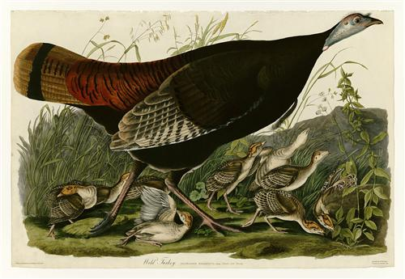
The Cause and Effect of Thankfulness
John James Audubon; wikiart.org

Slide 2
Source ➔ Hope ➔ Thankfulness ➔ Inner Peace

Slide 3
Thankfulness Leads to Inner Peace
Philippians 4.6-7 NET:
Do not be anxious about anything.
Instead, in every situation, through prayer and petition with thanksgiving, tell your requests to God.
And the peace of God that surpasses all understanding will guard your hearts and minds in Christ Jesus.

Slide 4
Thankfulness Leads to Inner Peace
Colossians 3.15-17 NET: Let the peace of Christ be in control in your heart (for you were in fact called as one body to this peace), and be thankful.
Let the word of Christ dwell in you richly, teaching and exhorting one another with all wisdom, singing psalms, hymns, and spiritual songs, all with grace in your hearts to God.
And whatever you do in word or deed, do it all in the name of the Lord Jesus, giving thanks to God the Father through him.

Slide 5
Hope Leads to Thankfulness
Psalms 119.49-50 NET:
Remember your word to your servant, for you have given me hope.
This is what comforts me in my trouble, for your promise revives me.

Slide 6
Hope Leads to Thankfulness
Romans 15.4 NET:
For everything that was written in former times was written for our instruction, so that through endurance and through encouragement of the scriptures we may have hope.

Slide 7
The Gospel Promise leads to Hope
1 Peter 1.3-6 NET: Blessed be the God and Father of our Lord Jesus Christ!
By his great mercy he gave us new birth into a living hope through the resurrection of Jesus Christ from the dead, that is, into an inheritance imperishable, undefiled, and unfading. It is reserved in heaven for you, who by God's power are protected through faith for a salvation ready to be revealed in the last time.
This brings you great joy, although you may have to suffer for a short time in various trials.

Slide 8
The Gospel Promise leads to Hope
1 Peter 1.3-6 NET: Blessed be the God and Father of our Lord Jesus Christ!
By his great mercy he gave us new birth into a living hope through the resurrection of Jesus Christ from the dead, that is, into an inheritance imperishable, undefiled, and unfading. It is reserved in heaven for you, who by God's power are protected through faith for a salvation ready to be revealed in the last time.
This brings you great joy, although you may have to suffer for a short time in various trials.

Slide 9
The Gospel Promise leads to Hope
Romans 5.1-6 NET: Therefore, since we have been declared righteous by faith, we have peace with God through our Lord Jesus Christ, through whom we have also obtained access by faith into this grace in which we stand, and we rejoice in the hope of God's glory. Not only this, but we also rejoice in sufferings, knowing that suffering produces endurance, and endurance, character, and character, hope. And hope does not disappoint, because the love of God has been poured out in our hearts through the Holy Spirit who was given to us. For while we were still helpless, at the right time Christ died for the ungodly.

Slide 10
The Gospel Promise leads to Hope
Romans 5.1-6 NET: Therefore, since we have been declared righteous by faith, we have peace with God through our Lord Jesus Christ, through whom we have also obtained access by faith into this grace in which we stand, and we rejoice in the hope of God's glory. Not only this, but we also rejoice in sufferings, knowing that suffering produces endurance, and endurance, character, and character, hope. And hope does not disappoint, because the love of God has been poured out in our hearts through the Holy Spirit who was given to us. For while we were still helpless, at the right time Christ died for the ungodly.

Slide 11
The Gospel Promise leads to Hope
Romans 5.1-6 NET: Therefore, since we have been declared righteous by faith, we have peace with God through our Lord Jesus Christ, through whom we have also obtained access by faith into this grace in which we stand, and we rejoice in the hope of God's glory. Not only this, but we also rejoice in sufferings, knowing that suffering produces endurance, and endurance, character, and character, hope. And hope does not disappoint, because the love of God has been poured out in our hearts through the Holy Spirit who was given to us. For while we were still helpless, at the right time Christ died for the ungodly.

Slide 12
We can be thankful and have peace
because we have hope for salvation
Colossians 2.6-7 NET:
Therefore, just as you received Christ Jesus as Lord, continue to live your lives in him, rooted and built up in him and firm in your faith just as you were taught, and overflowing with thankfulness.

